Slide 1
Crowdfunding Successful Forecast
Multivariate Data Analysis Team 10
Instructor: Amirhossein Gandomi
Chenkai Hang, Haihan Hu, Haodong Zhao

Slide 2

Introduction
Motivation:
Kickstarter is the world’s largest funding platform with various funding projects
We want to use the classification technique to determine which funding would success based on the current process
Methods:
We use web mining methods to scrap over 2400 funding data from Kickstarter, and use machine learning to analyze the data
By exploring the data, we help people understand which features would lead a success in funding project

Slide 3
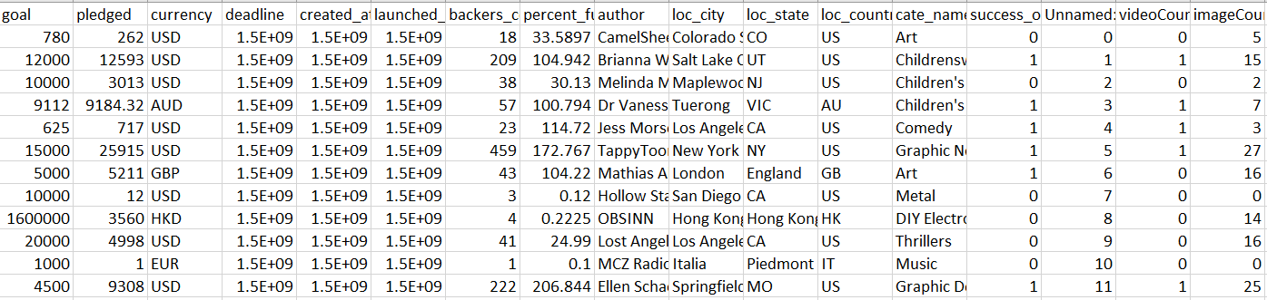
Data Processing
Data Mining:
Raw Data scraped from KickStarter
Issues:
Currencies are not Consistent
The form of Time is not available to calculate

Slide 4
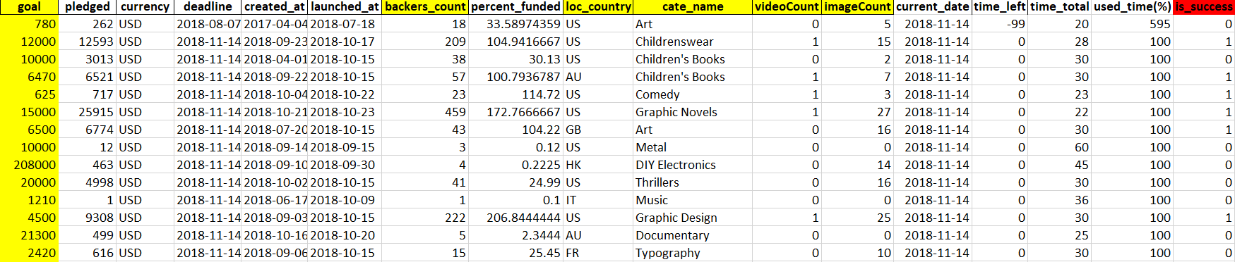
Data Processing
Data Cleaning:
Cleaned Data
Features:
We use six features, in yellow label, to run the analysis
We categorize the “loc_country” and “cate_name” into two more specific categories

Slide 5
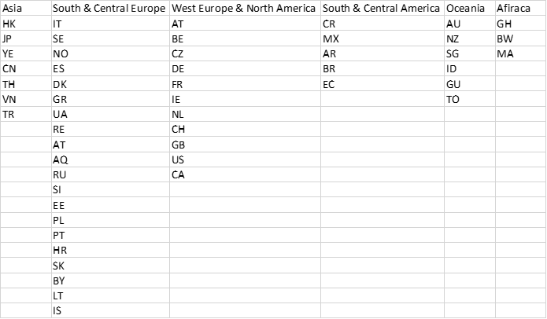
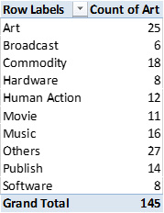
Detailed Categories
Gathered counties based on continents
Gathered and categorized all of the 145 categories to 10 genres

Slide 6
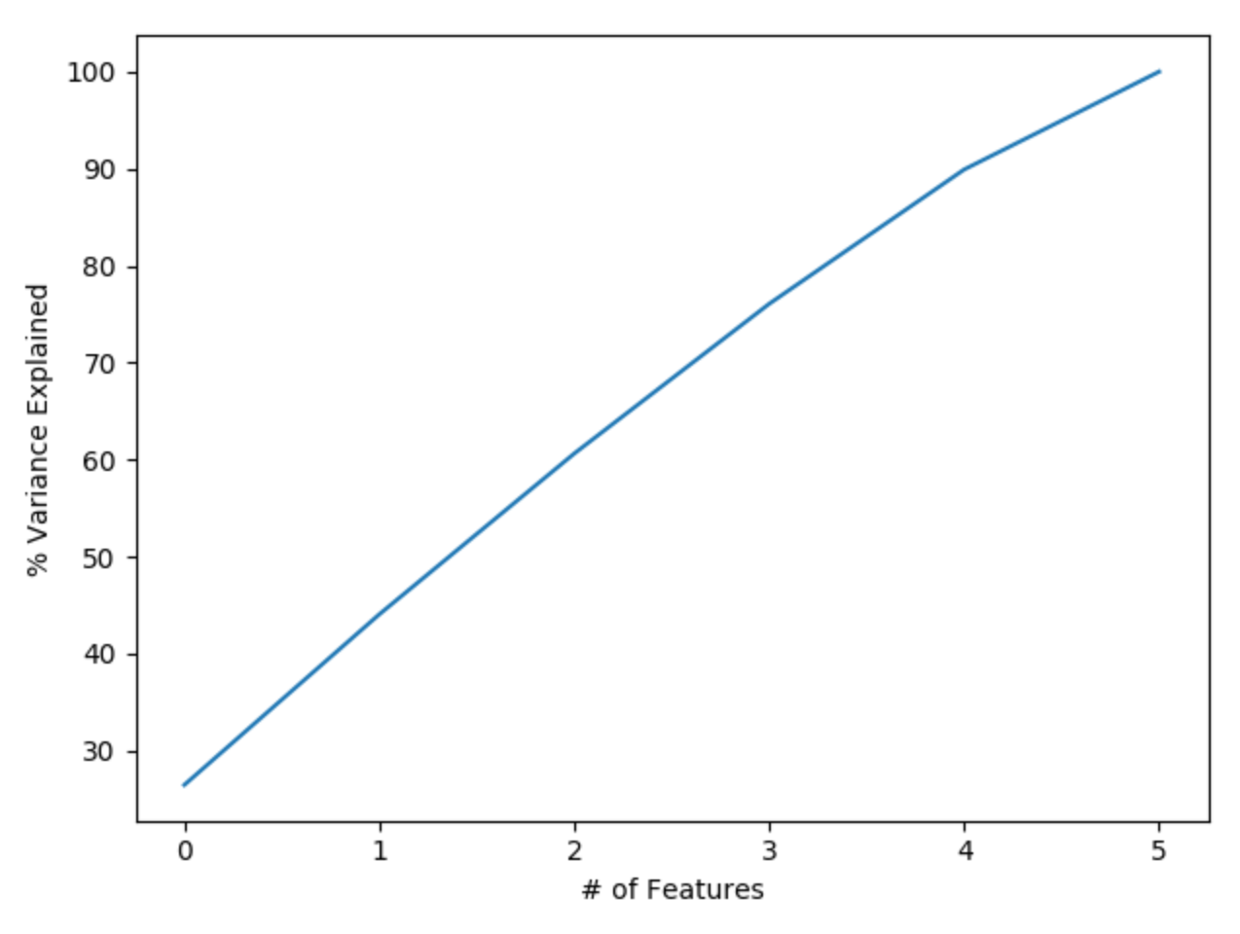
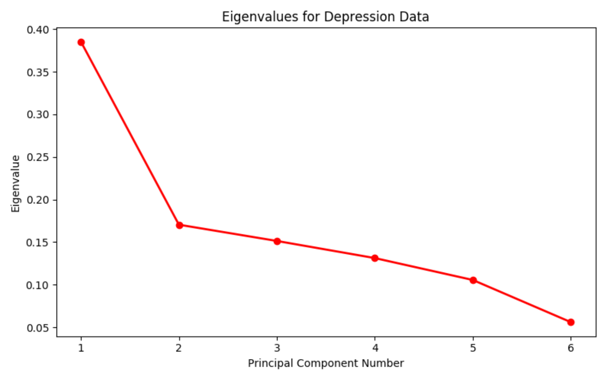
PCA
The plot shows all the components are very important
Scree plot
Notes:
I am gonna talk about pca. Actually the plot shows all the components are really important selecting 6 components I can preserve something around 98% of the total variance of the data.
And in the scree plot sorting the eigenvalues in descending order I decide to choose

Slide 7
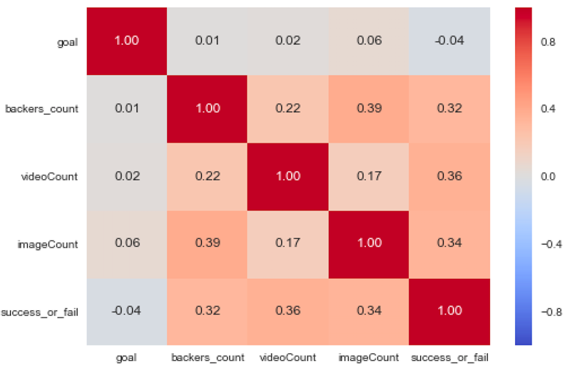
Correlation Matrix
Numerical variables
Video_count is highly related to the success of the projects

Slide 8
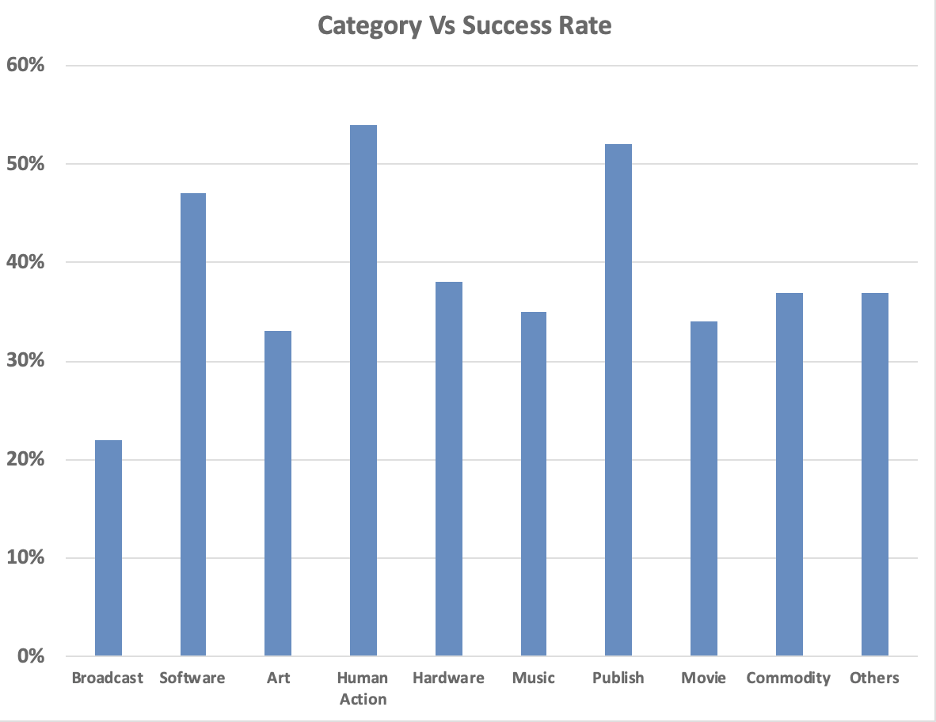
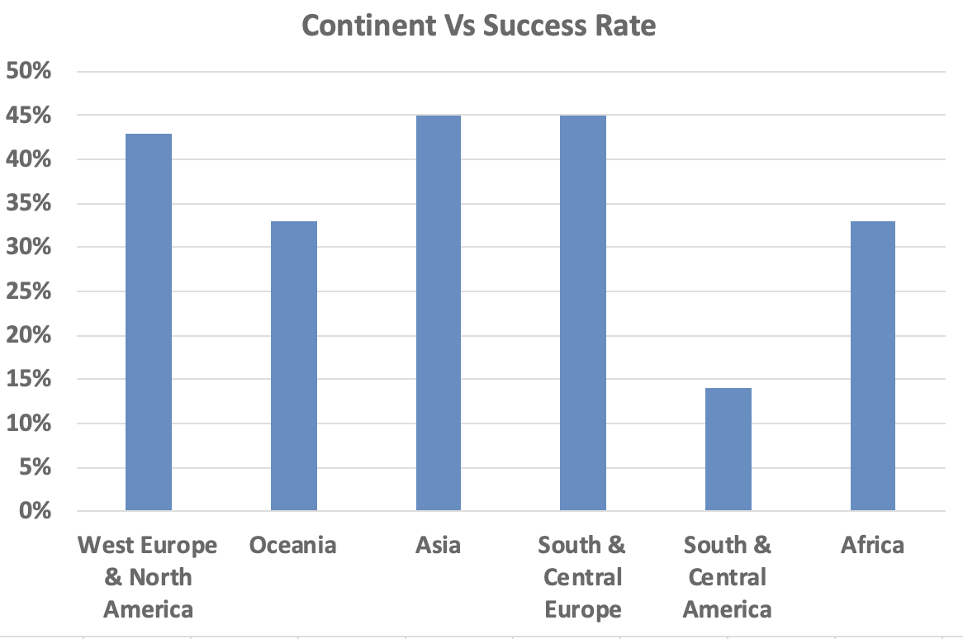
Data Visualization
Notes:
那国家不按地理分按什么分啊
就是显示来自哪里的project啊
很直观啊
可以看出哪里做项目的人多
以及哪里容易成功啊回头project再讨论吧

Slide 9
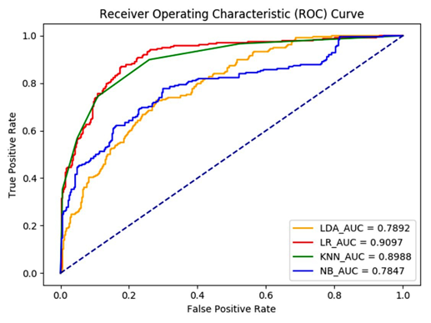
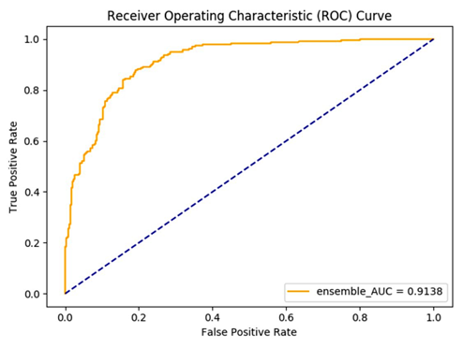
Data Modeling
Applying Model:
Curve of, LDA, LR, KNN, and NB modeling
Curve of ensembling the previous models

Slide 10
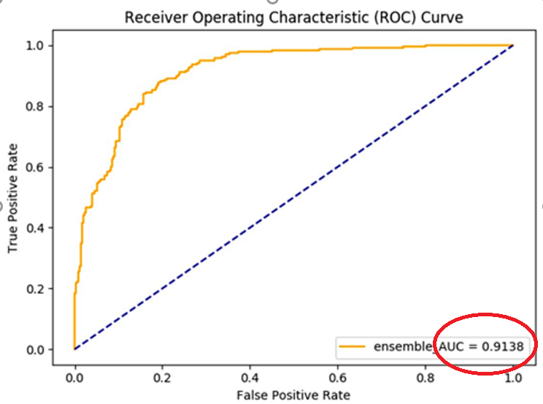
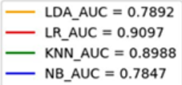
Data Modeling
Model Comparison:
Based on the accuracy, the Logistic Regression is the best model
By doing the ensemble method, the accuracy increased to 91%

Slide 11
Conclusions & Future Scopes
Data Results:
The K-Nearest-Neighbor model and the Logistic Regression model have a visibly high accuracy than the Linear Discriminant Analysis and Naive Bayes model
The ensemble method is overall improving our existing model
Real World Application:
We realize that several variables, such as number of videos showing in the project, have a high impact on whether the funding project would be successful
The category shows the funding project of Human Actions has the highest success rate, the country in East and Central Europe and Asia has the highest success rate

Slide 12

Thank you!

